Slide 1
Defensive Security
Marshall Applewhite
Matthew Bialas
Carson Bollinger
Lori Salazar
Jamie Sue Wilson

Slide 2
Table of Contents
This document contains the following resources:
Monitoring Environment
Scenario
Monitoring Results
Applications
Attack Analysis
Alerts
Reports
Dashboard
Project Summary & Future Mitigations
Notes:
Jamie Sue

Slide 3

Monitoring Environment
3

Slide 4
Scenario
Virtual Space Industries (VSI), a small company specializing in virtual-reality programs for businesses, commissioned our services to monitor potential cyber threats.
Rumors are a competitor, JobeCorp, are planning to disrupt operations. To safeguard VSI against suspicious activity, we utilized Splunk to monitor:
A Windows operating system - running VSI back-end operations.
An Apache web server - hosting an administrative webpage.
By analyzing historical logs, baselines were established to understand VSI's normal business operations. We then developed reports, alerts, and dashboards within the Splunk Docker container to enhance monitoring capabilities.
VSI reported experiencing several cyberattacks from JobeCorp, resulting in significant system disruptions. Additional logs were provided covering this attack period.
This report presents our findings from the attack, discusses monitoring solutions, and proposes future mitigation strategies to prevent such incidents.
Notes:
Jamie Sue

Slide 5
[“Add-On” App]
5
Notes:
Lori

Slide 6
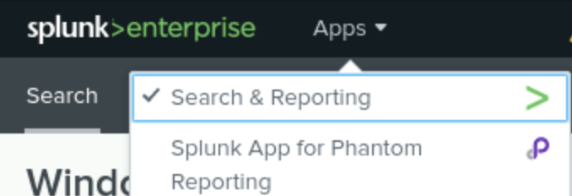
Splunk Phantom
Splunk Phantom is a (SOAR) solution.
The Splunk Phantom add-on automates security operations, making responses to security incidents quick and efficient. It simplifies tasks, organizes actions, and works together with security tools to improve incident management.
Notes:
Lori

Slide 7

Splunk Phantom
While monitoring the apache web server with splunk, we find a sudden surge in POST requests from a specific IP address, which could indicate a brute force attack.
We have an alert set up in splunk to trigger when a threshold for POST requests is exceeded. We can install Splunk Phantom for additional capabilities. Splunk Phantom can automatically execute response actions such as blocking the IP address associated with the attack or locking out the user account being targeted.
Notes:
Lori

Slide 8
Logs Analyzed
Windows Logs
Apache Logs
1
2
The Windows server contains intellectual property of VSI’s next-generation virtual-reality programs.
Windows_Logs contain security information about this server, including:
Signature
User
Status
Severity
Windows_Attack_Logs contain similar information, but sampling was pulled from the timeframe of a suspected attack.
Apache_Logs contain a sampling of normal use data for the Apache website server including:
IP addresses
HTTP Request Methods
HTTP Response Codes
Appache_Attack_Logs contain the similar information, but the sampling was pulled from the timeframe of a suspected attack.
Notes:
Carson

Slide 9
Windows Logs
9

Slide 10
Reports—Windows
Report Name | Report Description
Signatures and Signature ID’s | Displays the type of event logged and corresponding ID number.
Severity Counts and Percentages | Displays the level of severity, the count, and percentage of each event.
Windows Server Status | Displays the success/failure rate of the action being taken.

Slide 11
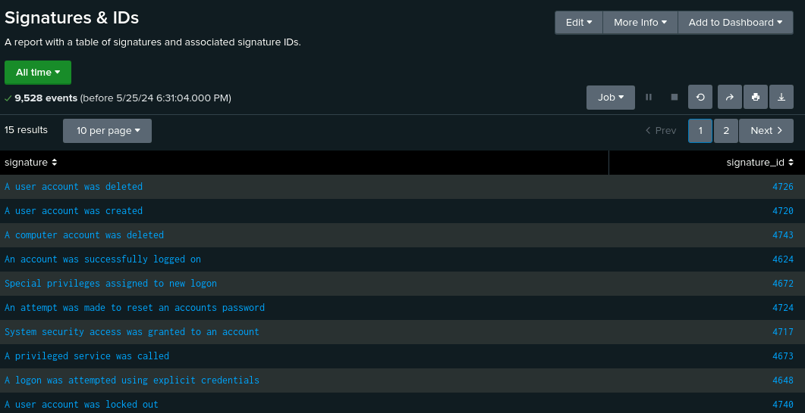
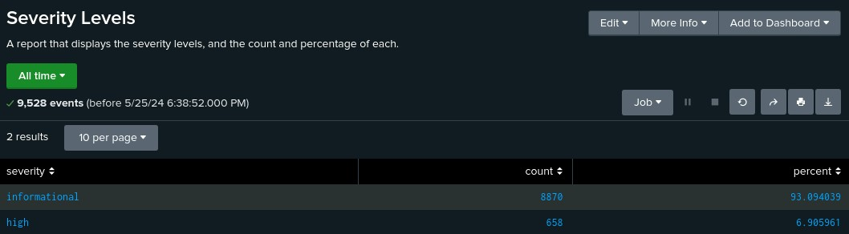
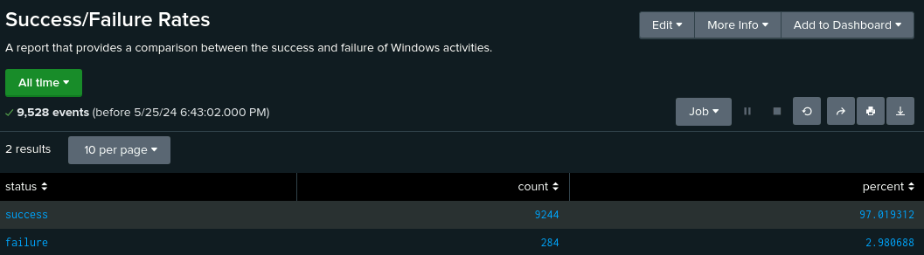
Images of Reports—Windows

Slide 12
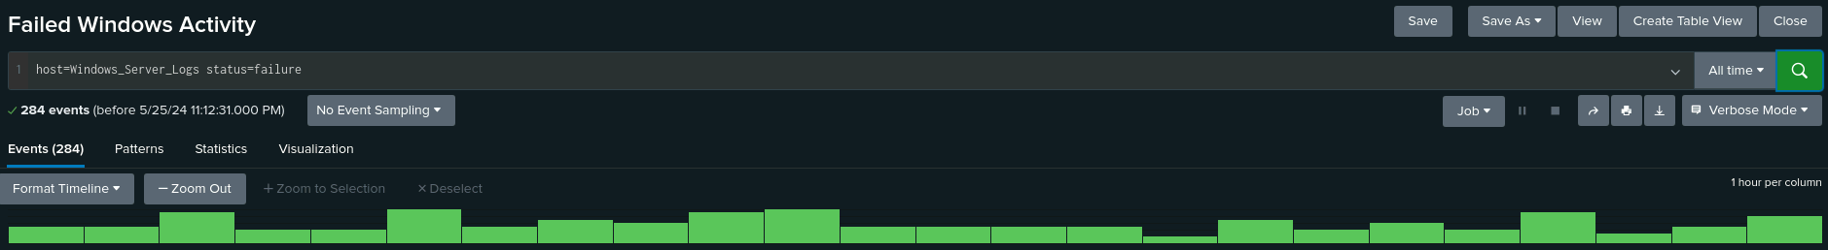
Alerts—Windows
Alert Name | Alert Description | Alert Baseline | Alert Threshold
Failed Windows Activity | Alerts when system has excess “failed events” | 10 | 25
JUSTIFICATION: Threshold set at 25 due to normal activity ranging between 10-20 hourly events, giving some tolerance before an alert is triggered.

Slide 13
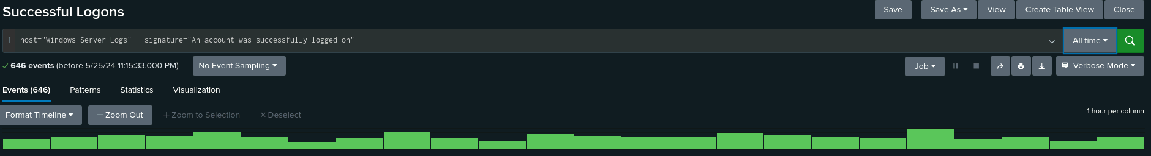
Alerts—Windows
Alert Name | Alert Description | Alert Baseline | Alert Threshold
Successful Logons | Alert when system has excess “account logons” | 25 | 50
JUSTIFICATION: Threshold set at 50 due to normal activity ranging between 20-40 hourly events on most days, giving some tolerance before an alert is triggered.

Slide 14
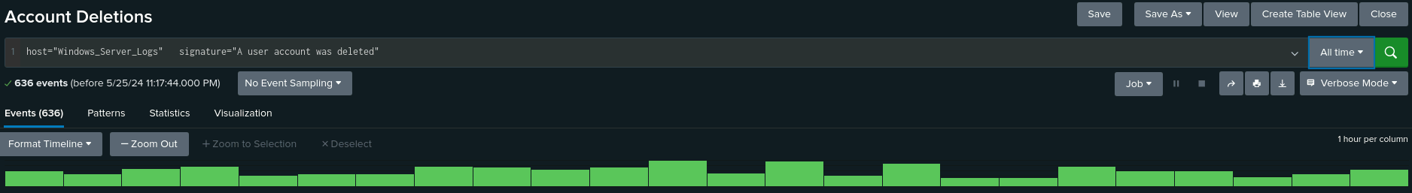
Alerts—Windows
Alert Name | Alert Description | Alert Baseline | Alert Threshold
Account Deletions | Alerts when system has excess “account deletions” | 25 | 50
JUSTIFICATION: Threshold set at 50 due to normal activity ranging between 20-40 hourly events on most days, giving some tolerance before an alert is triggered.

Slide 15
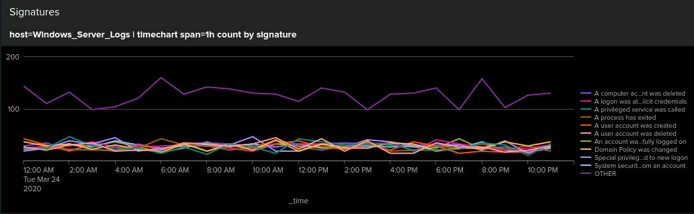
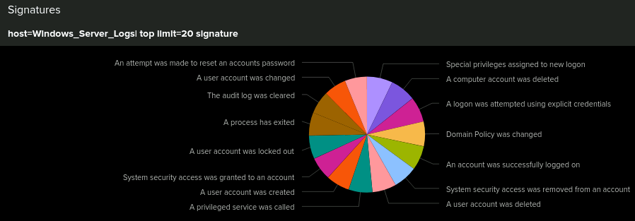
Dashboards—Windows

Slide 16
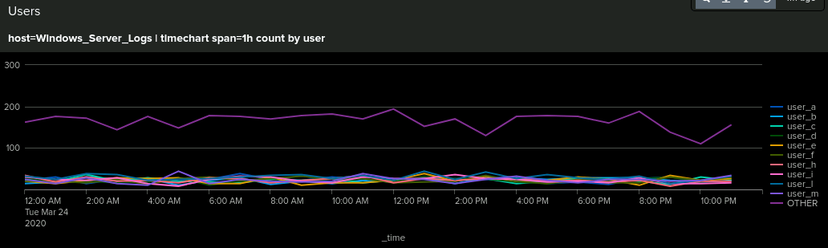
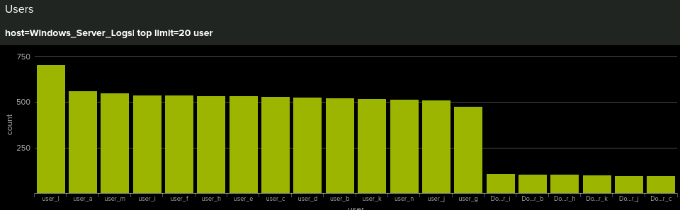
Dashboards—Windows

Slide 17
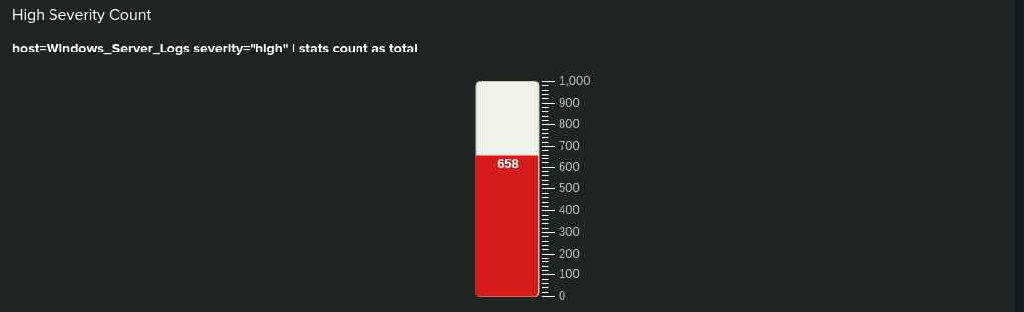
Dashboards—Windows

Slide 18
Apache Logs
18

Slide 19
Reports—Apache
Report Name | Report Description
HTTP Methods | Displays HTTP header types being run against VSI computers.
Referrer Domains | Displays top ten domains referring clients to the VSI domain.
HTTP Response Codes | Displays the count of each response code sent by the server.
Notes:
Carson

Slide 20
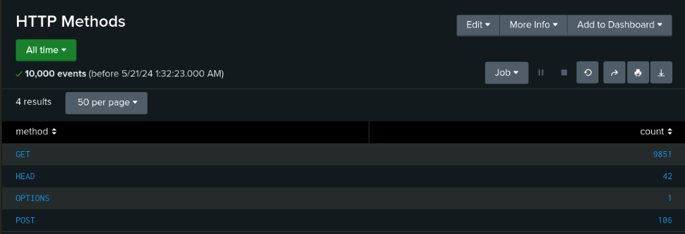
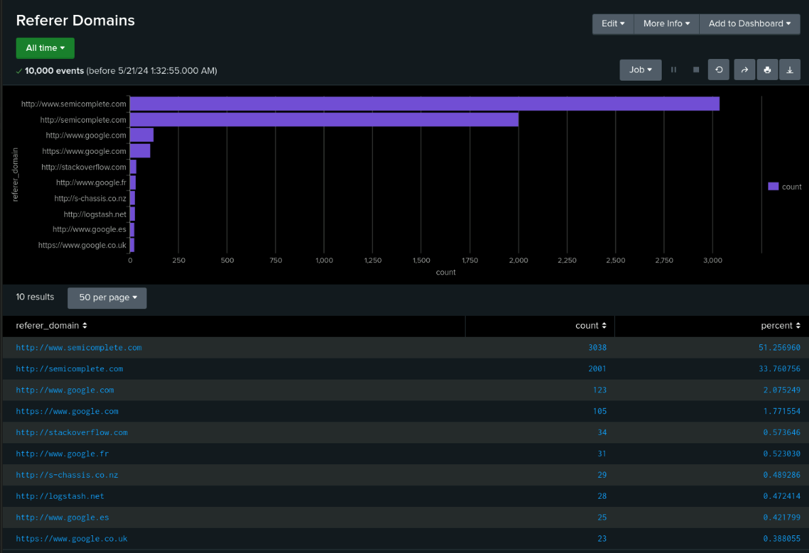
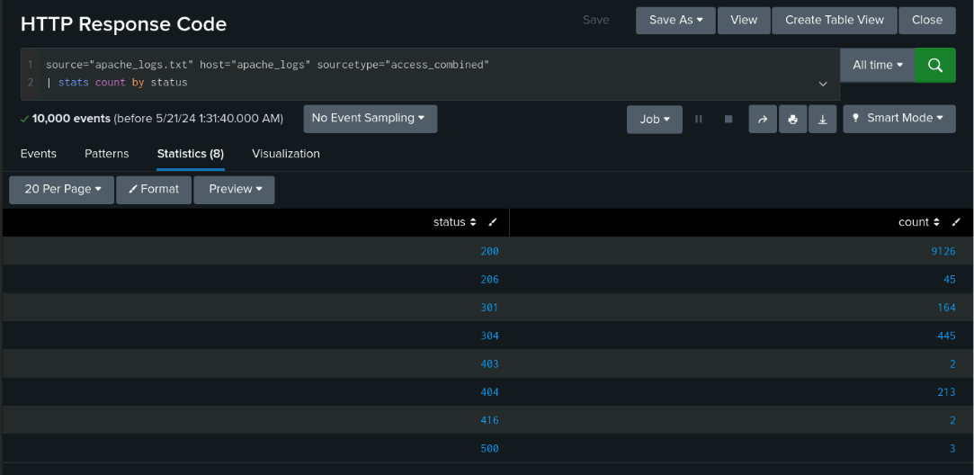
Images of Reports—Apache
Notes:
Carson

Slide 21
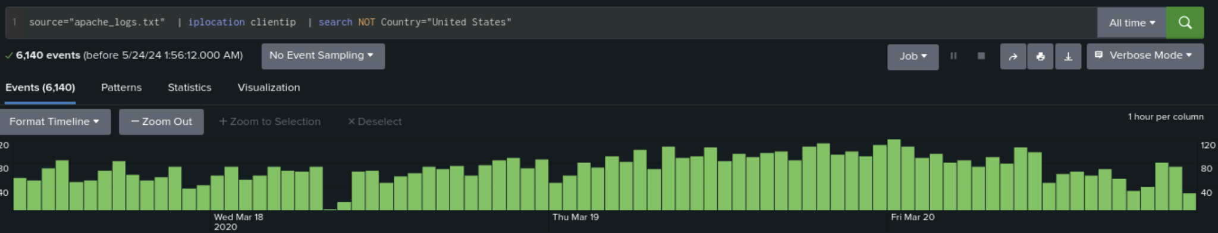
Alerts—Apache
Alert Name | Alert Description | Alert Baseline | Alert Threshold
Hourly Activity (non-US) | International activity event threshold of 50 has been surpassed. Attention required. | 50 | 100
JUSTIFICATION: Threshold set at 100 due to normal activity ranging between 50-100 hourly events, allowing this suggestion to be appropriate. A baseline of 50 gives ample room to operate without false positives.
Notes:
Marshall

Slide 22
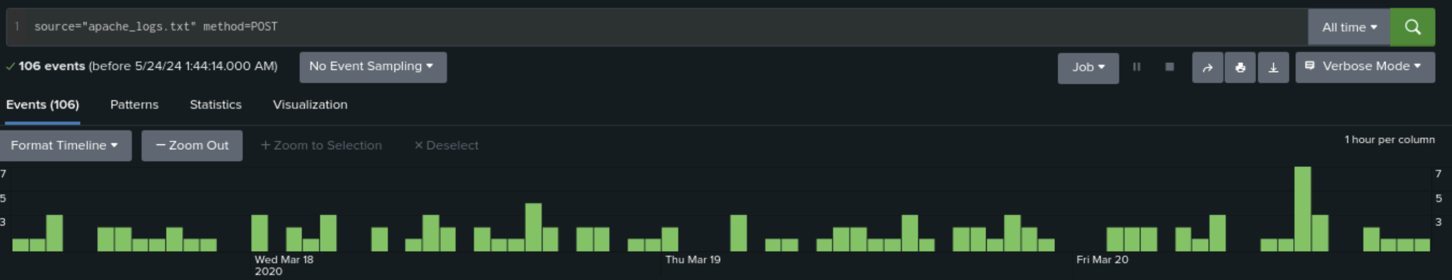
Alerts—Apache
Alert Name | Alert Description | Alert Baseline | Alert Threshold
HTTP POST | POST request threshold of 5 has been surpassed. Attention required. | 2 | 5
JUSTIFICATION: Threshold set at 5 considering normal activity was no higher than 4, with an exception of 7 in one hour, and regarded as appropriate.
Notes:
Marshall

Slide 23
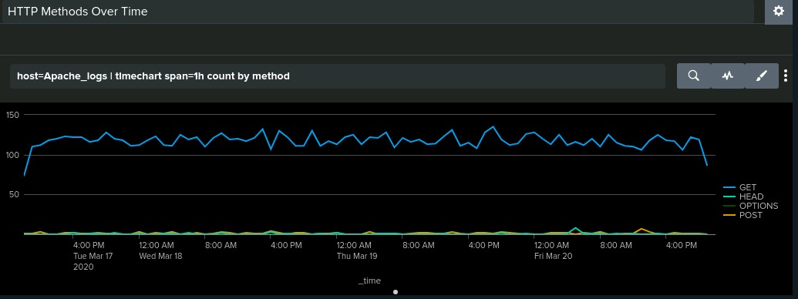
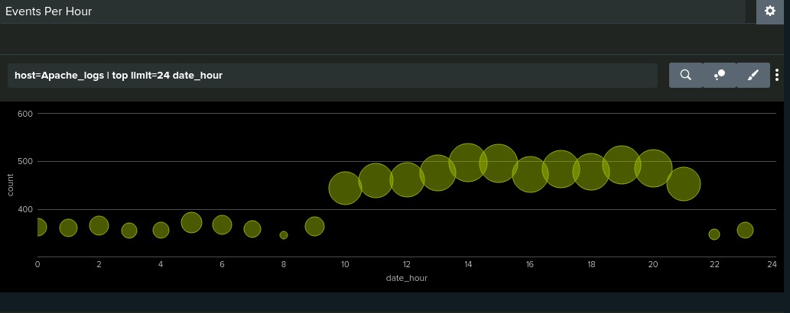
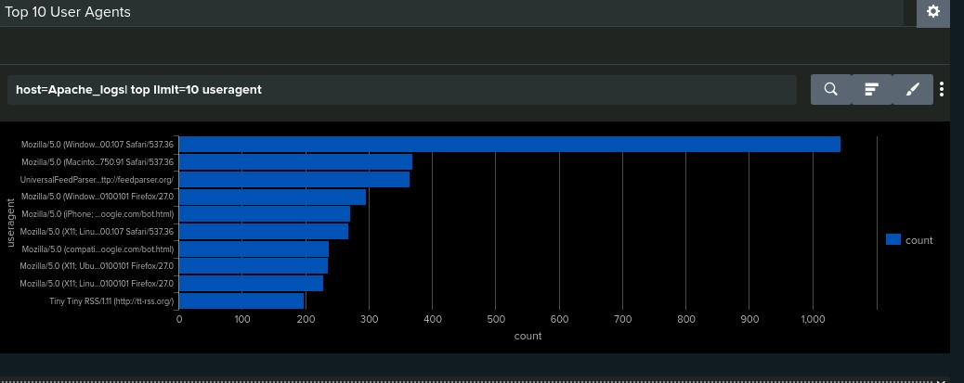
Dashboards—Apache
Mozilla/5.0 (Windows NT 6.1; WOW64) AppleWebKit/537.36 Chrome/32.0.1700.107 Safari/537.36
Notes:
Matthew

Slide 24
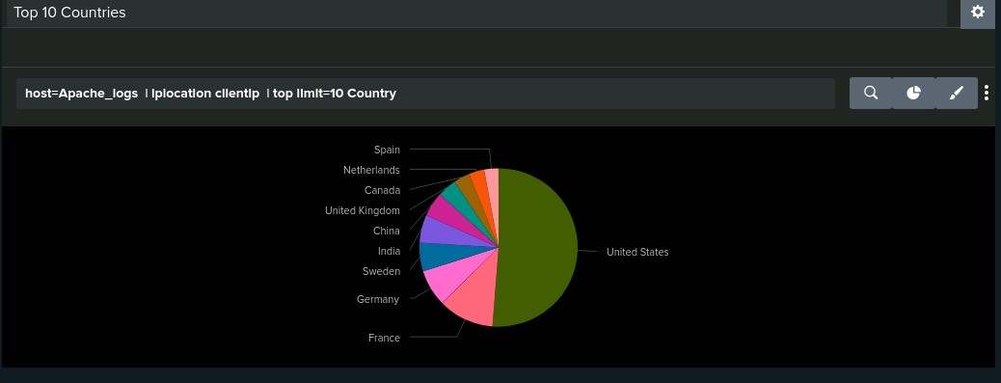
Dashboards—Apache
USA: 51% France: 11% Germany: 8%
Notes:
Matthew

Slide 25
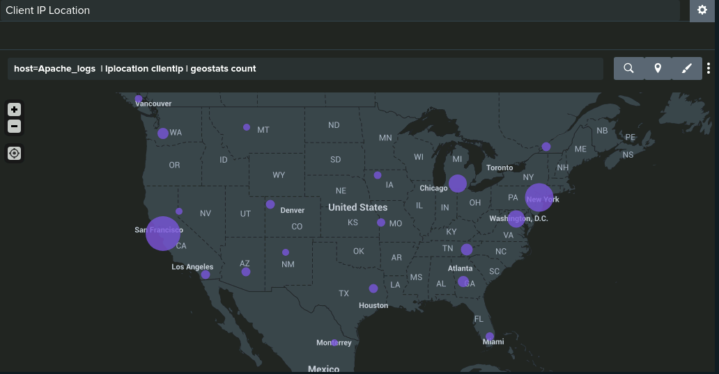
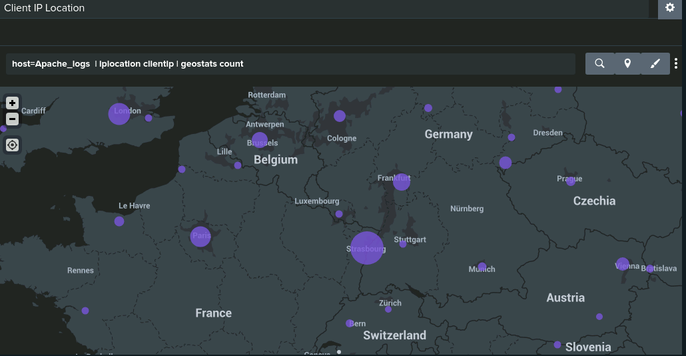
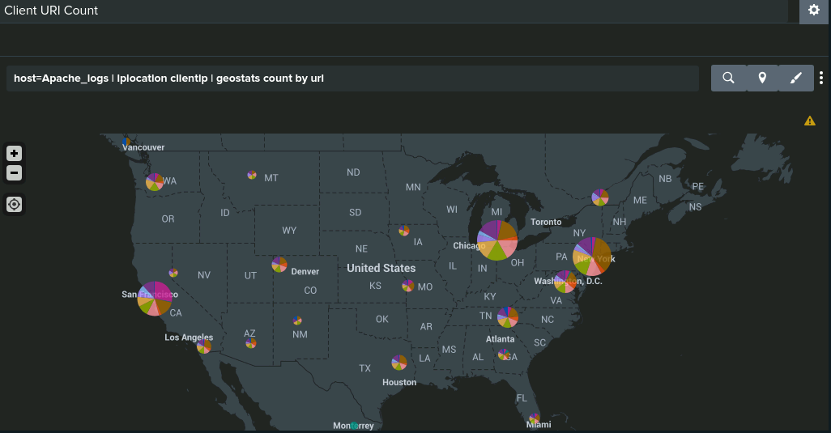
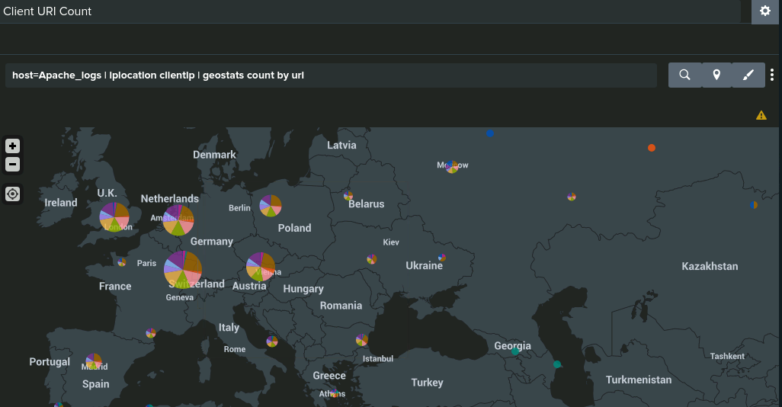
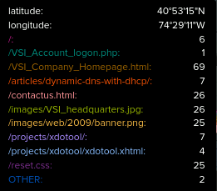
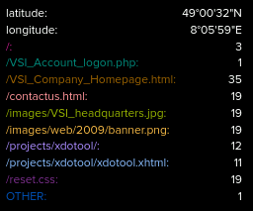
Dashboards—Apache
Notes:
Matthew

Slide 26
Attack Analysis
26

Slide 27
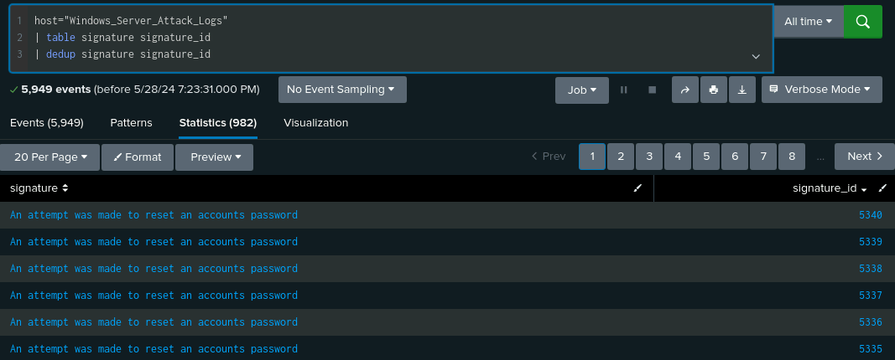
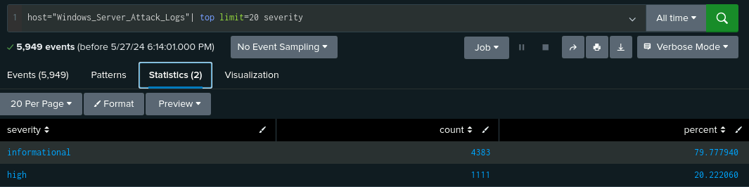
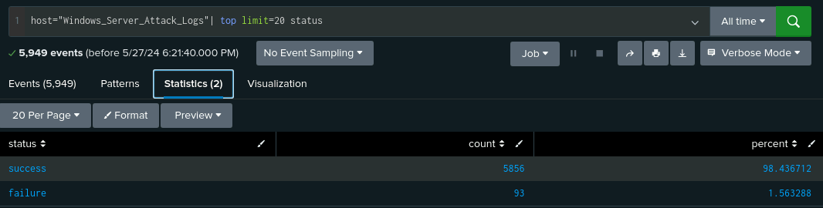
Attack Reports Summary—Windows
Signatures & IDs: A large increase in ‘password reset attempts’ was identified, with various Signature IDs attached.
Due to the number of attempts, this was regarded as suspicious activity.
Severity Counts and Percentages: ‘Informational’ events decreased from 93% to 80%, while ‘high’ severity events increased from 7% to 20%.
Windows Server Status: Our ‘success’ rate increased slightly from 97% to 98%, while our ‘failure’ rate decreased slightly from 3% to 1.5%.
This was regarded as potential malicious activity going undetected by the server.

Slide 28
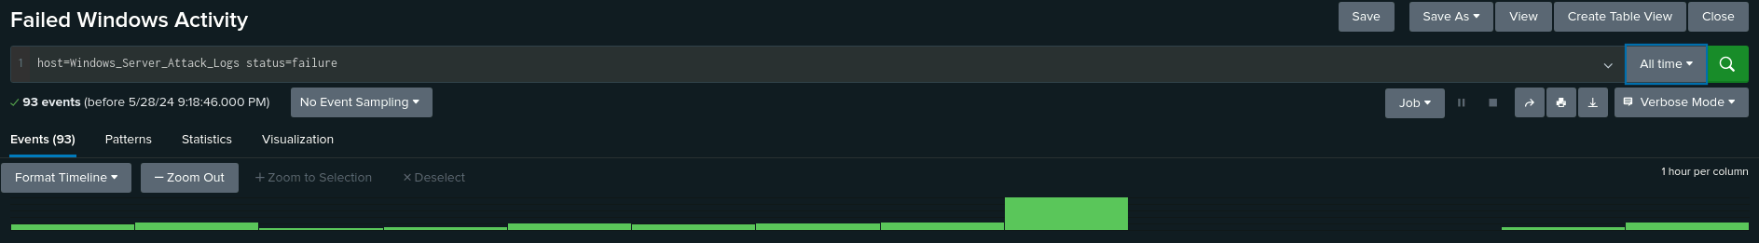
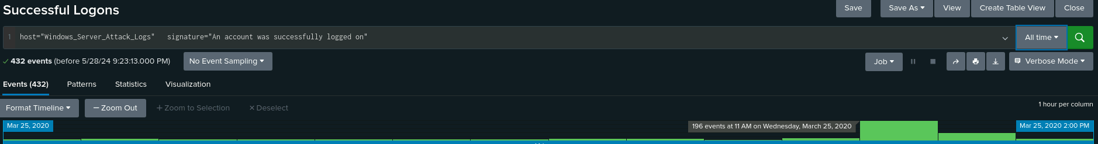
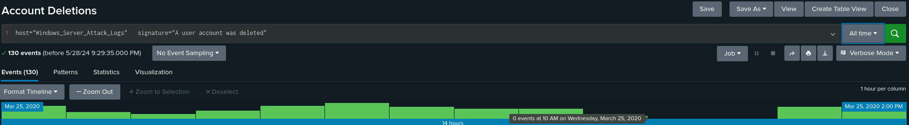
Attack Alerts Summary—Windows
Failed Windows Activity: Our threshold appears accurate as we set a limit of 25 and an alert would have been triggered due to an instance of 35 events. Instances of zero failed events were also identified.
Successful Logons: Our threshold appears accurate as we set a limit of 50 and the alert would have been triggered due to an instance of 196 events. Prior to this, an instance of zero events was again identified.
Account Deletions: Our threshold and alert here would not have been triggered due to no events passing our threshold of 50.
A third odd instance of zero accounts being deleted on the date of suspected attack was identified.
In this case, malicious activity was most likely being directed to other areas, including password resets, or masked as alternate data.

Slide 29
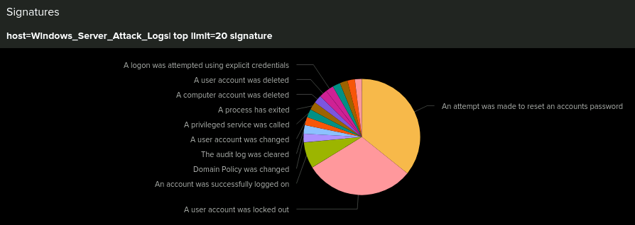
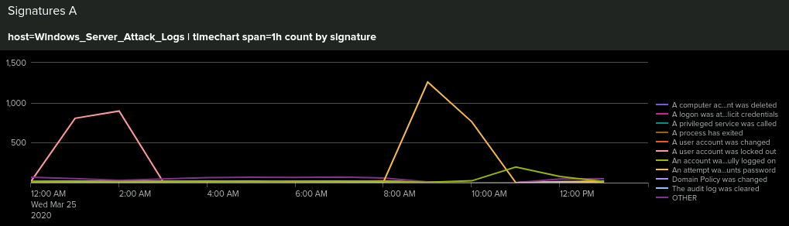
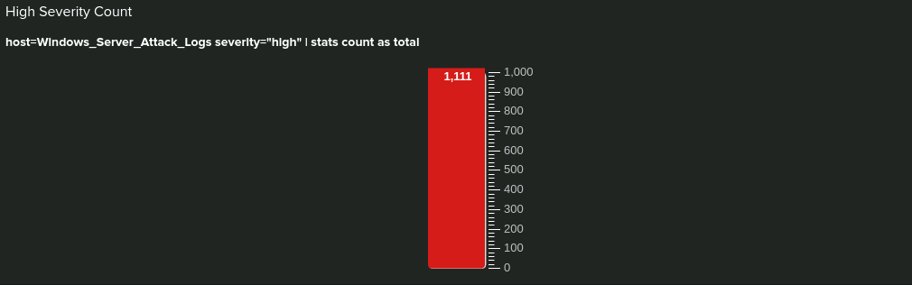
Attack Dashboards Summary—Windows
Based on the data collected from analyzing Reports, Alerts, and Dashboards against our baseline data, we believe these events to be a coordinated password reset phishing attack on March 25, 2020.
12:00am: A malicious user attempts lockout of user accounts.
8:00am: Users attempt access back into locked accounts, potentially by malicious reset links.

Slide 30
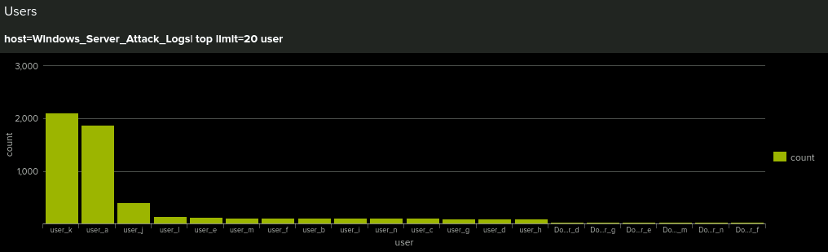
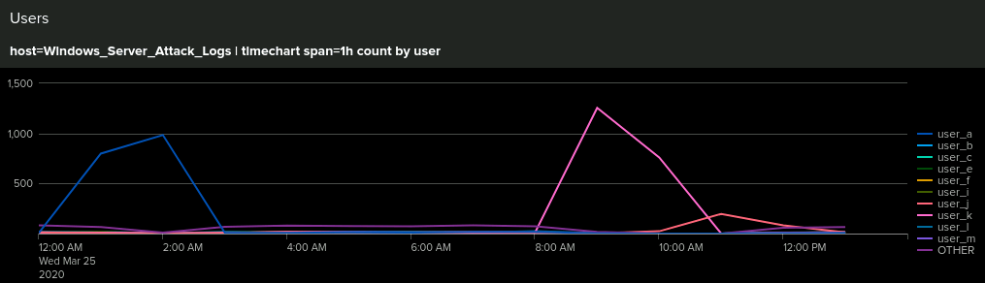
Attack Dashboards Summary—Windows

Slide 31
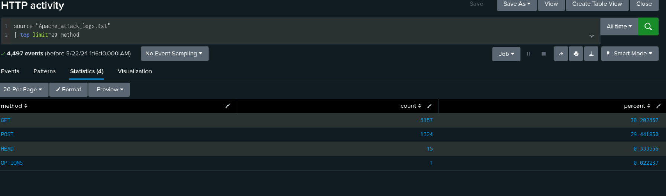
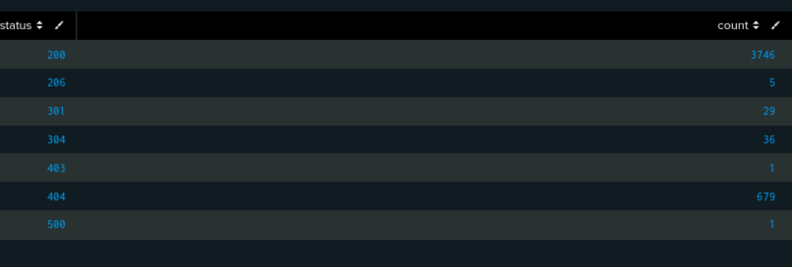
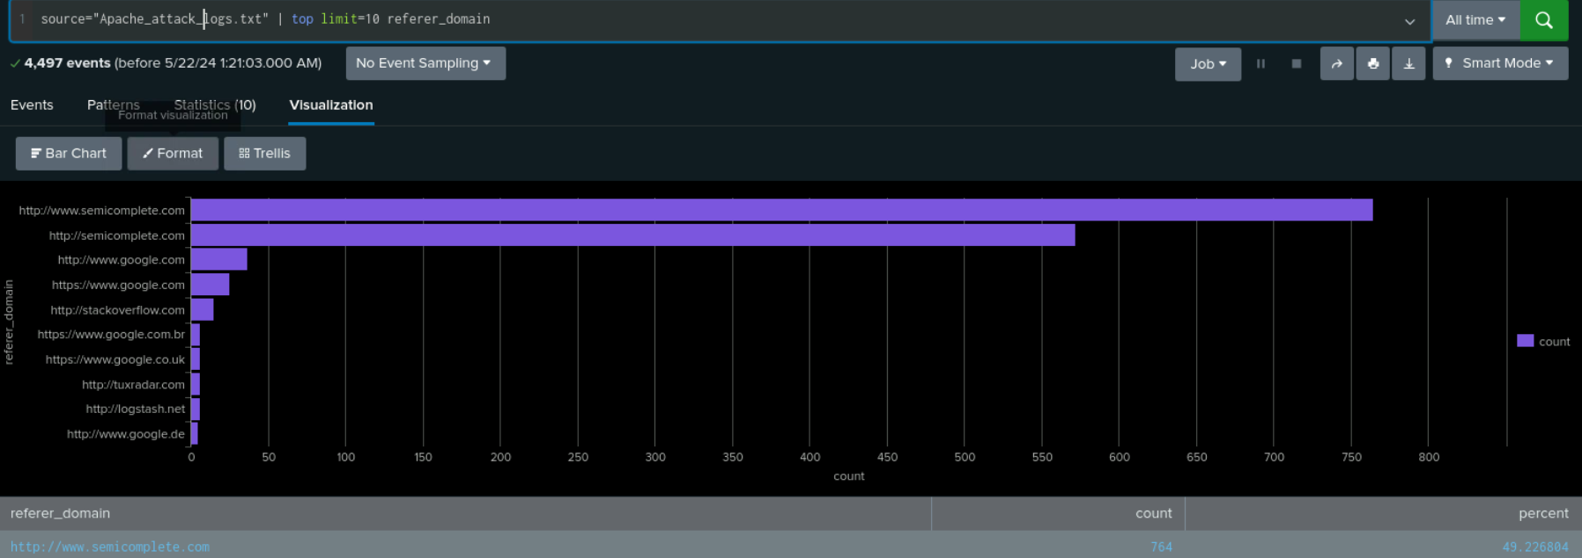
Attack Reports Summary—Apache
HTTP methods: Shows a drastic increase in POST request percentages from 1% to 29.4%.
Response Codes: Shows an increase in 404 errors from 213 to 679.
Referrer Domains: Shows a drastic decrease in total with the main referrer, from 3000+ to 764.
Notes:
Carson

Slide 32
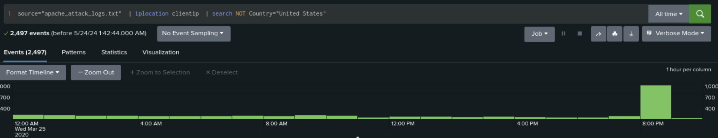
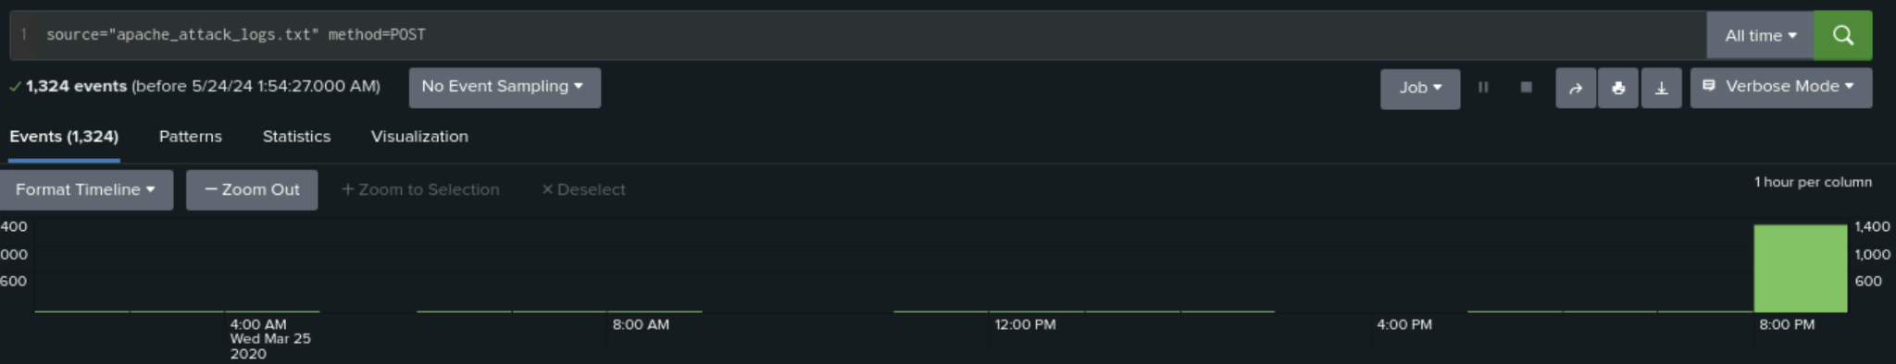
Attack Alerts Summary—Apache
After analyzing the attack logs we realized the set thresholds were low, resulting in excessive false alerts. After review, new thresholds were determined.
Hourly Activity (non-US): During the attack, logs revealed 937 events compared to the previous maximum of 120.
We determined 100 was not acceptable, increasing the threshold to 150. The attack was drastically higher than previously believed questionable activity.
HTTP Post: Logs also revealed 1,296 events, much higher than the previous maximum of 7.
Considering the previous max was slightly higher than during normal business hours, we raised the threshold to 10 for certainty of notification during abnormal activity.
Notes:
Marshall

Slide 33
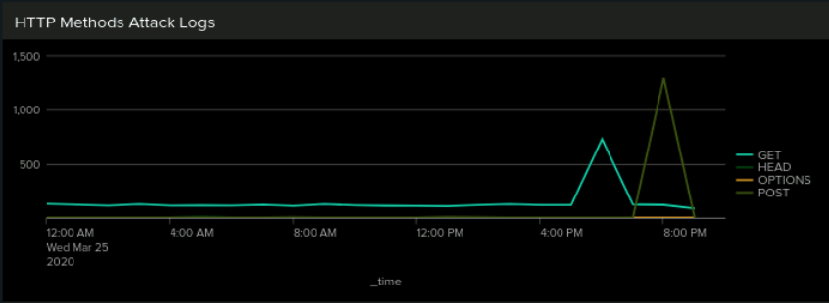
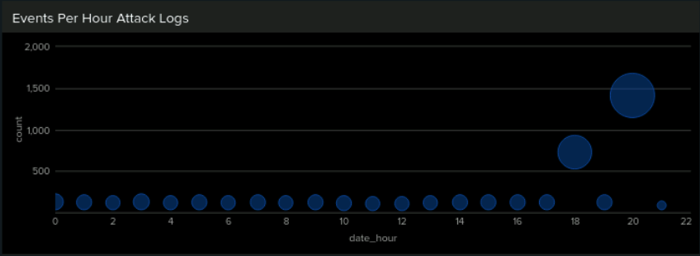
Attack Dashboards Summary—Apache
Based on the data collected from analyzing Reports, Alerts, and Dashboards against our baseline data, we believe two separate attacks took place. The first beginning at 5:00pm, lasting until 7:00pm. The second attack beginning at 7:00pm, lasting until 9:00pm.
Events per Hour
Notes:
Jamie Sue

Slide 34
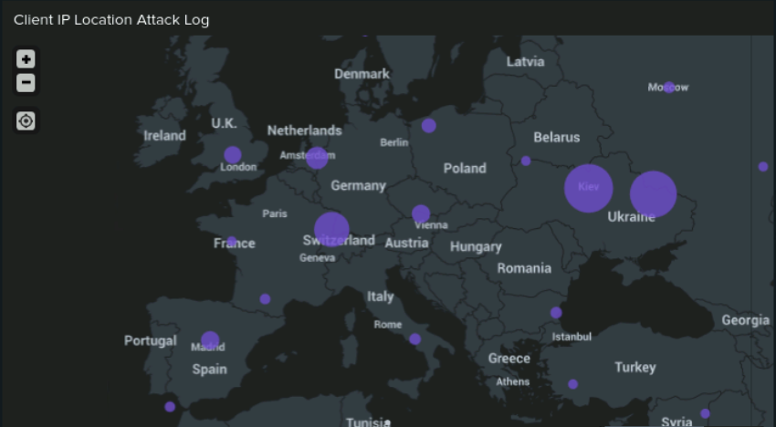
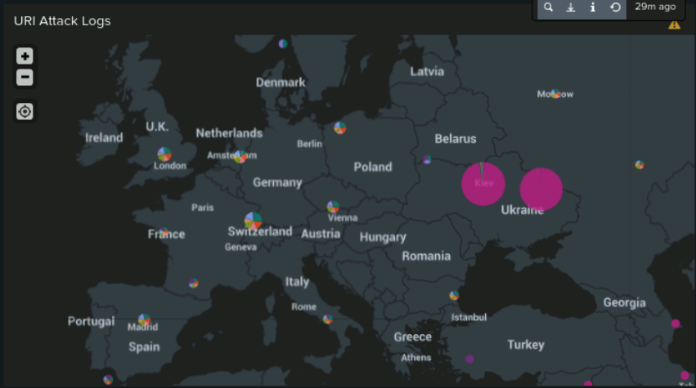
Attack Dashboards Summary—Apache
The attacks originated from Ukraine and the United States.

Slide 35
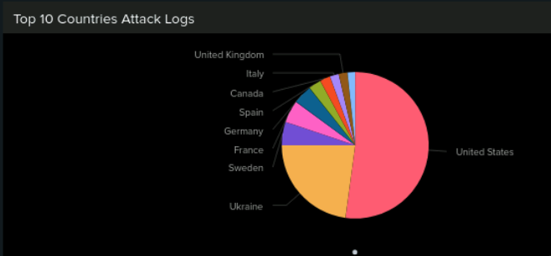
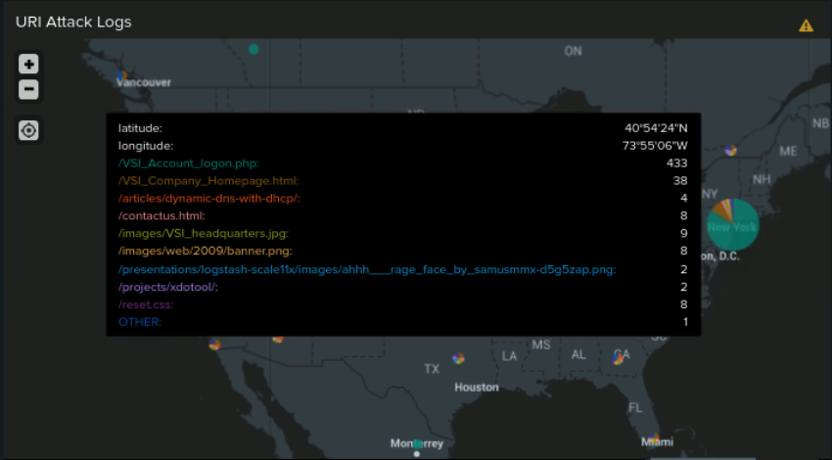
Attack Dashboards Summary - Apache
Notes:
Jamie Sue

Slide 36
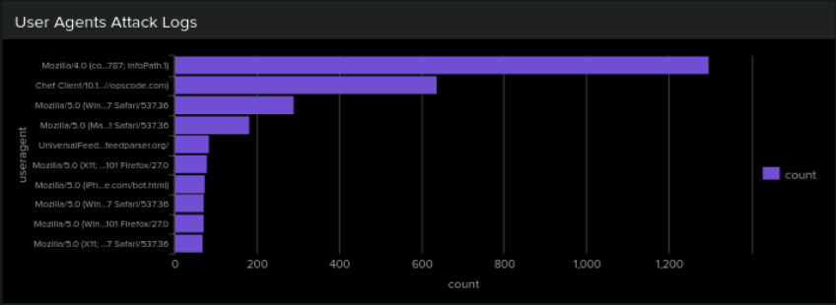
Attack Dashboards Summary - Apache
Mozilla/4.0 (compatible; MSIE 6.0; Windows NT 5.2; SVI; .NET CLR 2.0.50727987787; InfoPath.1)
Notes:
Jamie Sue

Slide 37
Summary and Future Mitigations
37

Slide 38
Project 3 Summary
What were your overall findings from the attack that took place?
Attacks to the VSI Windows and Apache servers took place on March 25, 2020.
12:00am: User account lockout. Password Phishing attack.
8:00am: Users attempt access back into accounts via Phishing links.
5:00pm: DDOS attack utilizing a botnet & User Agent Spoofing.
7:00pm: Brute Force Attack from New York & Ukraine.
Future mitigation recommendations
Implement a firewall policy to prevent sudden surges in traffic from specific regions.
Improve password policies to strengthen security.
Implement account lockout measures after repeated login attempts.
Enforce two-factor authentication for additional verification.
User training and awareness on various phishing attack methods.
Monitor all servers globally to be sure updates/patches are fully distributed.
Block outdated or unique User Agent strings to prevent reverse engineering of patches.
Notes:
Matthew - Summary / Lori - Mitigations

